Slide 1
Testing of Keep-It-Fresh bags for Flowers

Slide 2
ETHYLENE PROBLEM
Ethylene is a gas naturally produced by fruits and flowers as it ripens
Ethylene works as an accelerator to the ripening process
Ethylene increases ripening exponentially
Ethylene adsorbers reduce the ripening rate by adsorbing the ethylene molecules.
Ethylene molecules form a bond with the keep-it-fresh additives and are trapped

Slide 3
Technology
Anti-Microbial
&
Ethylene Adsorbers

Slide 4
Anti Microbials
PLASTIC FILM

Slide 5
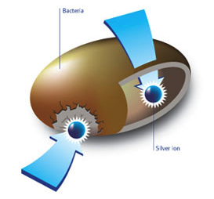
How Silver Ions Work?
BACTERIA
Cell Membrane is de-stabilized
Respiration is prohibited
Food nutrition intake is impeded
Cell Division is inhibited
SiLVER ION

Slide 6
ETHYLENE PROBLEM
ETHYLENE PRODUCTION FROM DIFFERENT FRUITS & VEGETABLES
LOW <1.0 ml/kg/hr | MODERATE 1-10 ml/kg/hr | HIGH 10-100 ml/kg/hr | VERY HIGH >100 ml/kg/hr
Pineapple, artichoke, cauliflower, broccoli, date, orange, spinach, beet root, green asparagus, celery, lemon | Banana, mango, plum, tomato | Apricot, nectarine, pear, peach | Apple, Avocado, cherimoya, passion fruit

Slide 7
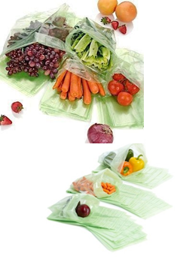
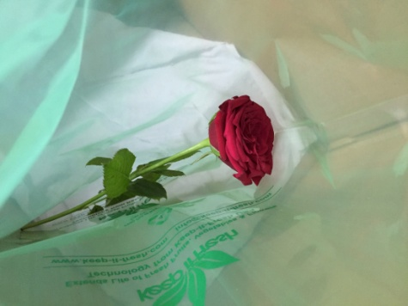
Keep It Fresh Bags
Made from food grade Polyethylene resins.
Leave no harmful residues and are human safe.
Preserve the freshness of perishables at room temperature
as well as in refrigerator
Certified and approved for food contact applications
USFDA Tested by SGS Labs
Recyclable

Slide 8
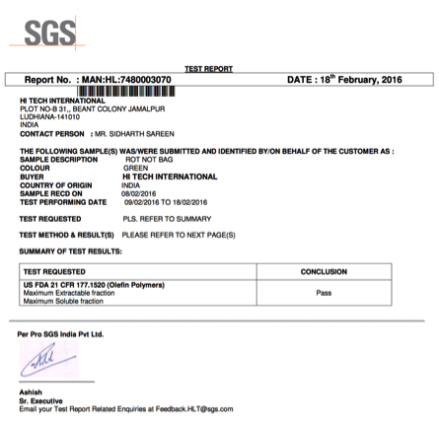
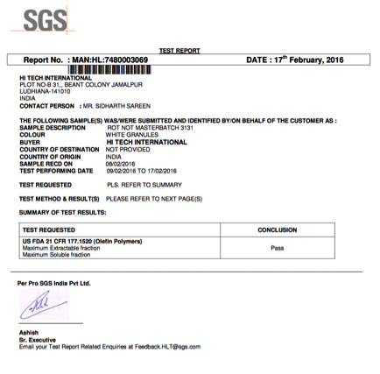
USFDA Testing from SGS Passes USDFA 21 CFR177.1520 (Olefin Polymers)

Slide 9
TESTING on Flowers

Slide 10
Day 1
Flower in Normal Bag
Flower in Keep It Fresh Bag

Slide 11
Day 3
Flower in Normal Bag
Flower in Keep-It-Fresh Bag

Slide 12
Day 7
Flower in Normal Bag
Flower in Keep-It-Fresh Bag

Slide 13
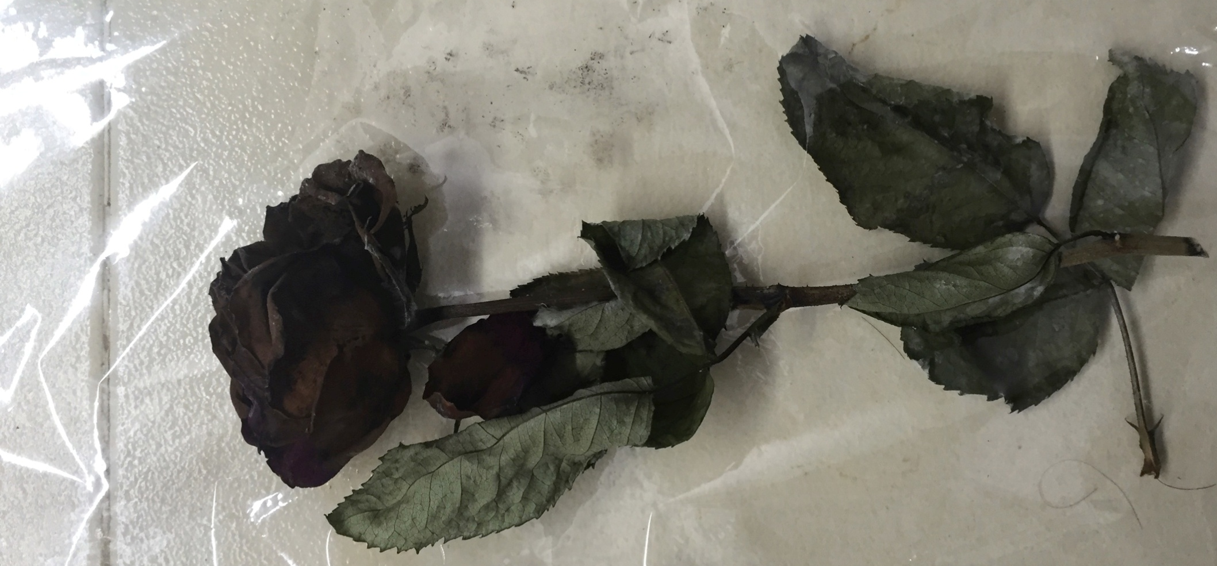
Day 7 – Normal bag

Slide 14
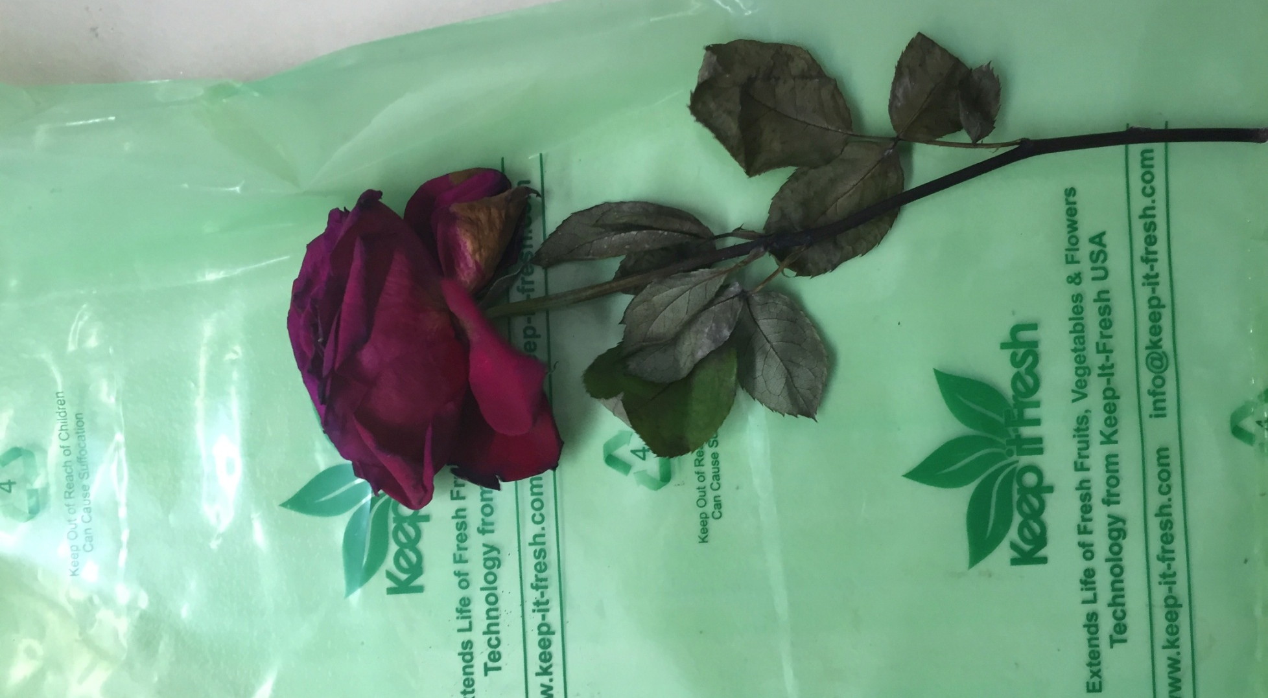
Day 7 – Keep-It-Fresh Bag

Slide 15
Results
Flowers kept in Keep-It-fresh bags last longer than the normal bags
The flower in keep-it-fresh bag maintained its freshness after 2 days compared to the one in normal bag which began to lose its petals
The flower in Normal bag dried and developed fungal growth after 7 days where as the one in keep-it-fresh bag looked much better.
The Keep-It-Fresh bags undoubtedly extend the shelf life of fresh flowers as seen in the test.

Slide 16
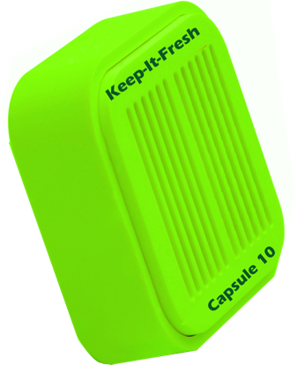
Also available Keep-It-Fresh Capsules
Plastic Capsules for 10 cubic feet
Can be placed in refrigerators and with fresh produce
Also available with adhesive backing

Slide 17
Thanks!
SHELF LIFE EXTENSION FROM KEEP-IT-FRESH

