Slide 1
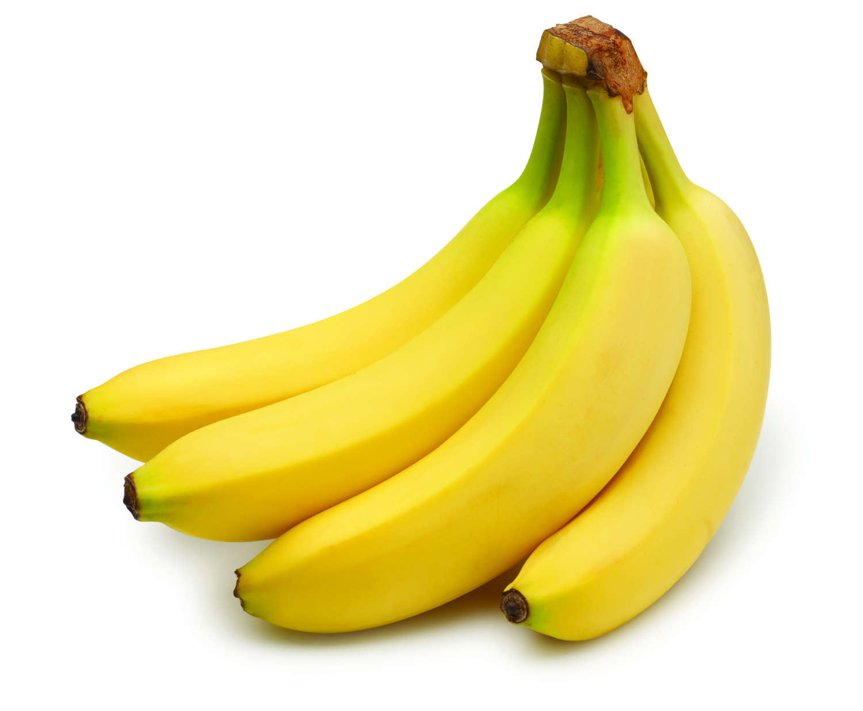
Keep-It-Fresh Bags
Testing of bananas

Slide 2
What happens after 14 days to a banana stored in normal conditions of 68 F max and 45 F min

Slide 3
Bananas in open condition
Bananas Day 1
Bananas Day 14

Slide 4
Shelf life enhancement using a Semper Fresh 6% MB Bag?

Slide 5
Bananas packed in SF 6% film
Increases Life Increases Profits
SF MB @ 6%
SF MB @ 6%
Bananas Day 1
Bananas Day 14
Very slight deterioration compared to the deterioration without packaging. The bananas after 14 days look as deteriroated as 3 days old bananas in open. The shelf life seems to have extended by 5 Times or 500%

